Slide 1
POULTRY SCIENCE: Poultry Health
Unit 9

Slide 2
Poultry Science: Poultry Health
Unit 9: Segment 1
Introduction

Slide 3
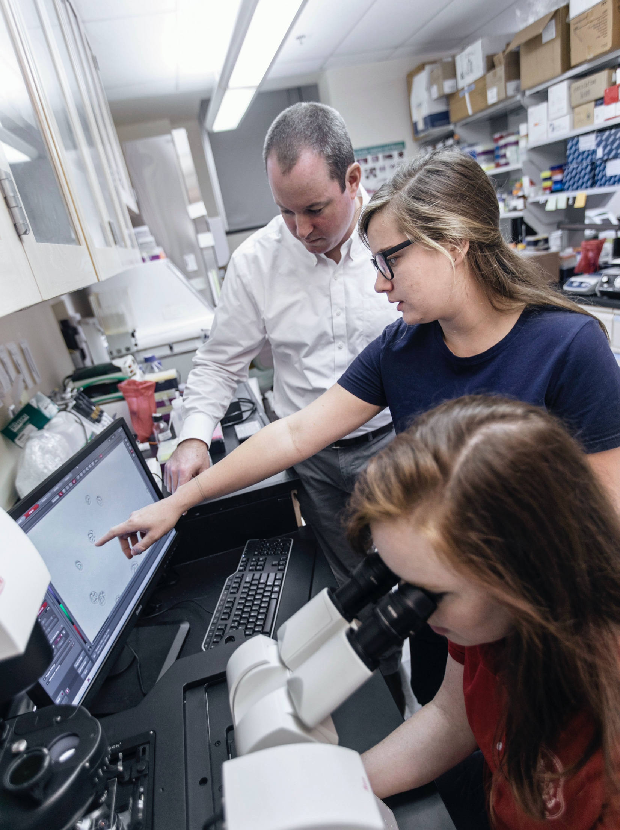
Poultry Diseases
Over time and through highly-pressured selected breeding, chickens and turkeys have lost a lot of their natural immune function.
Our intense production system often places them into situations (high stocking density, short down time between flocks, etc.) that could promote disease outbreaks if not handled properly.

Slide 4
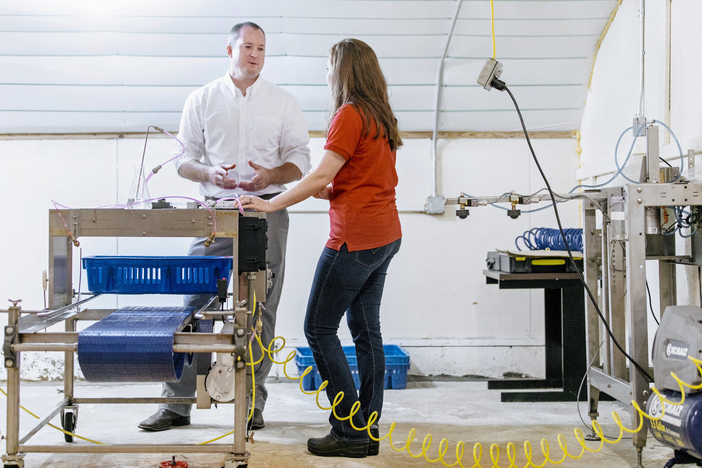
Poultry Diseases
Disease outbreaks are one of the most costly and preventable situations in poultry production!
This makes proper biosecurity measures all the more vital – the welfare and economic impact could be devastating.
Testing vaccination equipment at the University of Georgia

Slide 5
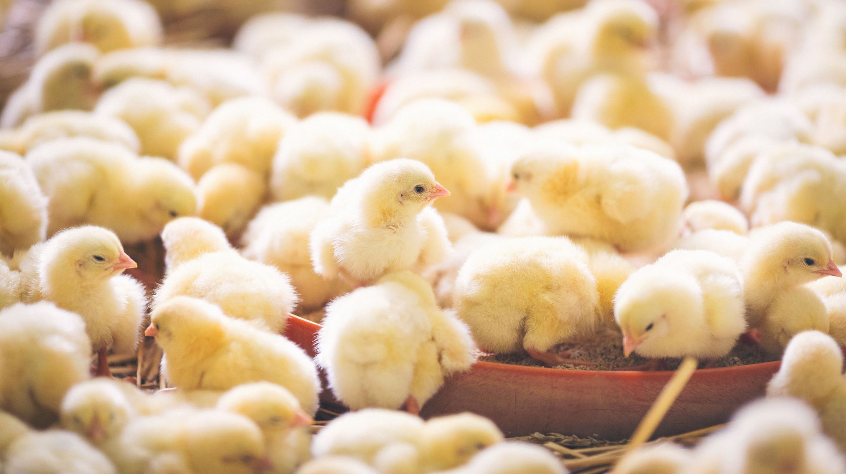
Poultry Diseases
There are two main body systems that are the focus of many disease presentations:
Respiratory Tract
Enteric Tract
These two systems make up the majority of tissue found inside the body cavity of birds.

Slide 6
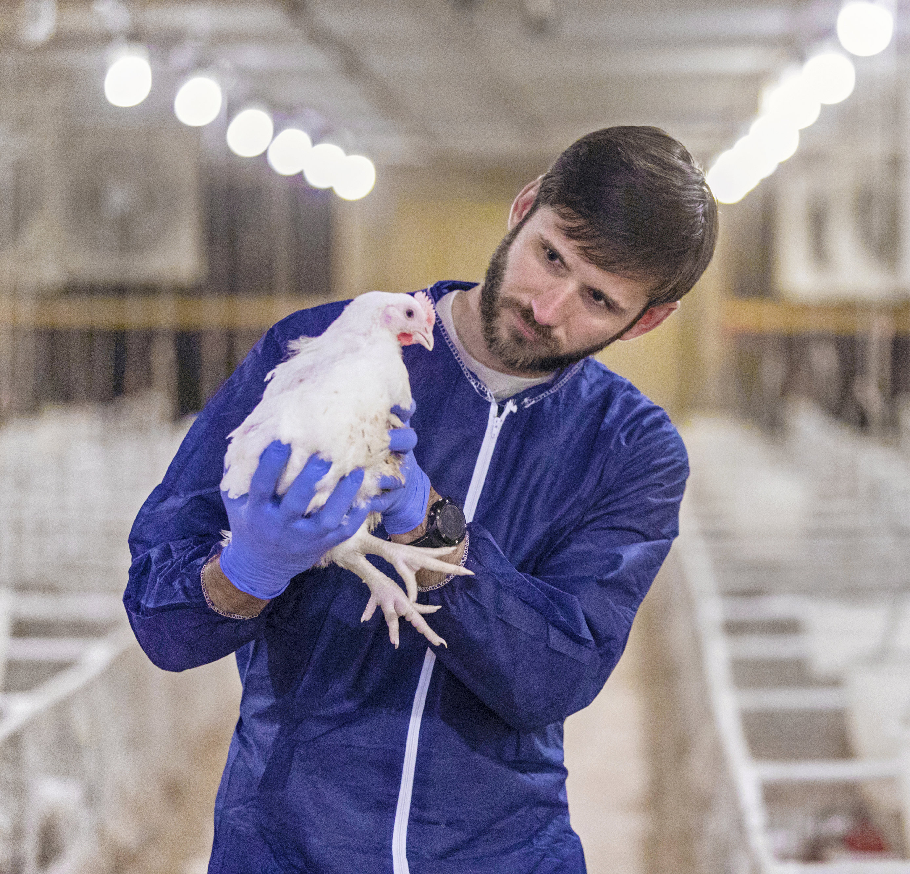
Respiratory Diseases in Poultry
In general, respiratory diseases do not cause significant mortality.
The respiratory challenges faced in the U.S. poultry industry are very costly, particularly those that lead to condemnation and money lost at processing.
Respiratory diseases may also lead to a slight drop in performance, but usually not major.

Slide 7
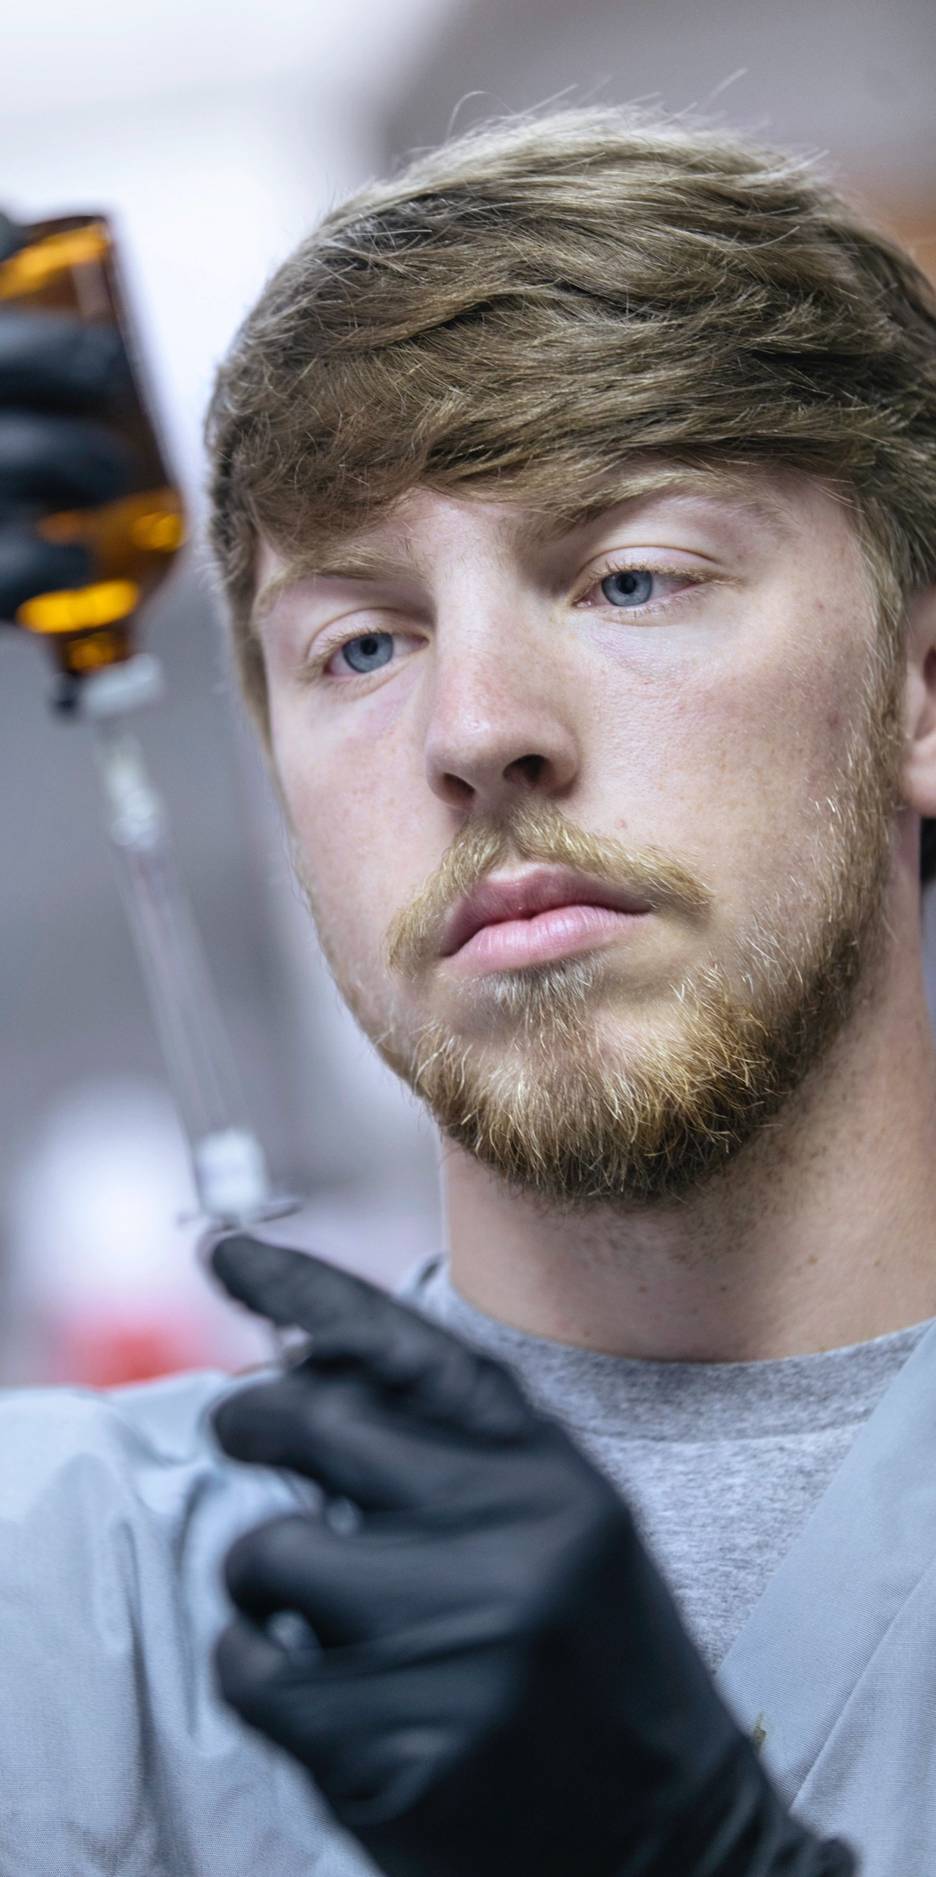
Enteric Diseases in Poultry
Enteric diseases can cause significant mortality as well as performance loss.
Losses usually occur prior to reaching processing stages.
The major cost associated with enteric diseases is in lost performance and treatments.

Slide 8
Enteric Diseases in Poultry
There are many other systems that can be affected by pathogens leading to a disease state.
Musculoskeletal, nervous, metabolism (nutritional), immune, tumors, etc.
Some are easier to recognize (i.e. Marek’s = tumors) than others (musculoskeletal diseases).
Some may not be able to be narrowed down at all, like nutritional deficiencies.

Slide 9
Terminology
Necropsy – an autopsy performed on an animal
Clinical Sign – something indicating the presence or existence of something else
Always external
May or may not involve physical injury
Lesion – an injured or diseased spot or area on/in the body
Anything internal is a lesion
Some external injuries may be lesions as well

Slide 10
Fun Fowl Fact:
“Symptom” is not a correct term in animal health, as it is a description you get from a patient…and animals can’t talk!

Slide 11
Poultry Science: Poultry Health
Unit 9: Segment 2
Poultry Illnesses

Slide 12
Coccidiosis
Protozoal disease of the intestinal tract of poultry
Most expensive and common disease of commercial poultry
Spread through infected birds, litter, or egg contamination from parent flock
Characterized by:
Mild-severe enteritis (diarrhea)

Slide 13
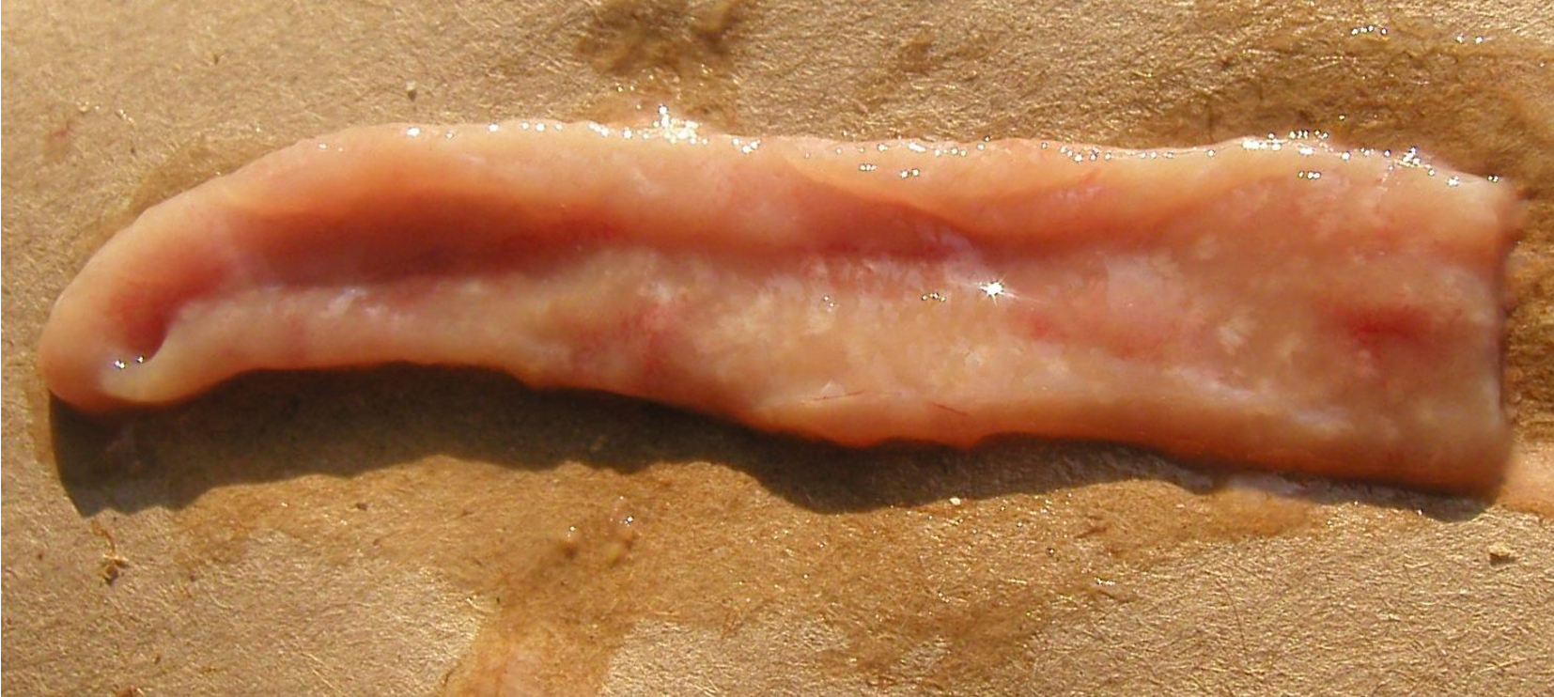
Notice white specks in this portion of digestive tract.

Slide 14
Aspergillosis (“Brooder Pneumonia”)
Respiratory disease found in young chicks/poults
Common mold (Aspergillus fumigatus) that infects birds through infected eggs on a contaminated breeder farm or through the hatchery, feed, or litter.
Chronic form usually occurs in adult turkeys and less commonly in chickens.
No effective treatment available.
Characterized by:
Respiratory distress
Acute death
Typical pearl-like lesions in the lungs and air sacs

Slide 15
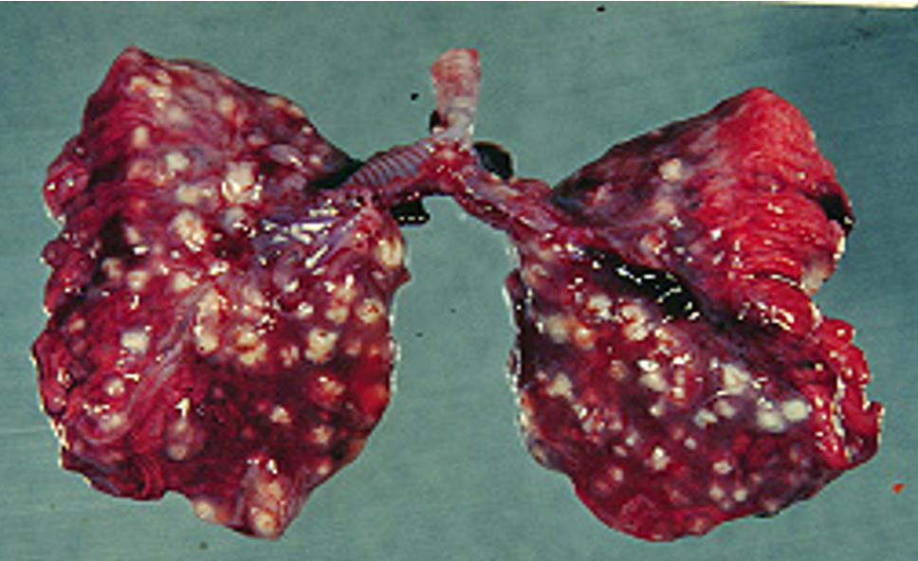

Slide 16
Marek’s Disease
Highly infectious herpes viral disease in chickens (mostly young, sexually immature birds)
Viral incubation of 4-12 weeks, so signs are slow to develop even though it is very contagious
Transmitted through inhalation of virus-containing feather follicle dander
High morbidity, but mortality generally only occurs in unvaccinated birds
Characterized by:
Varying degrees of paralysis of the wings and legs
Tumors in affected organs
Large feather follicles
Depression
Diarrhea
Blindness
Pale, shriveled combs

Slide 17
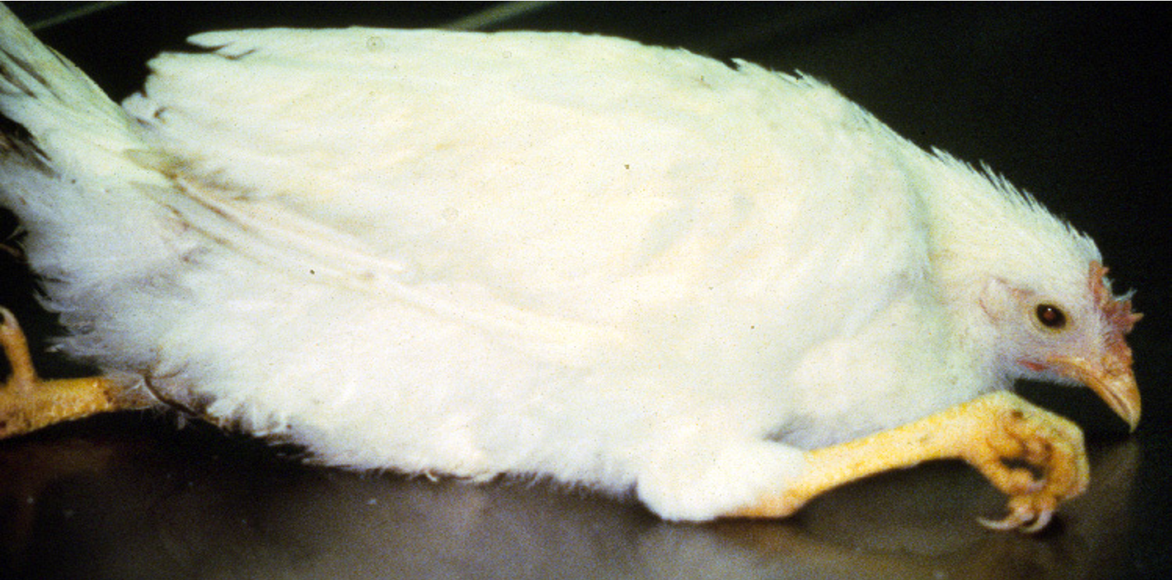

Slide 18
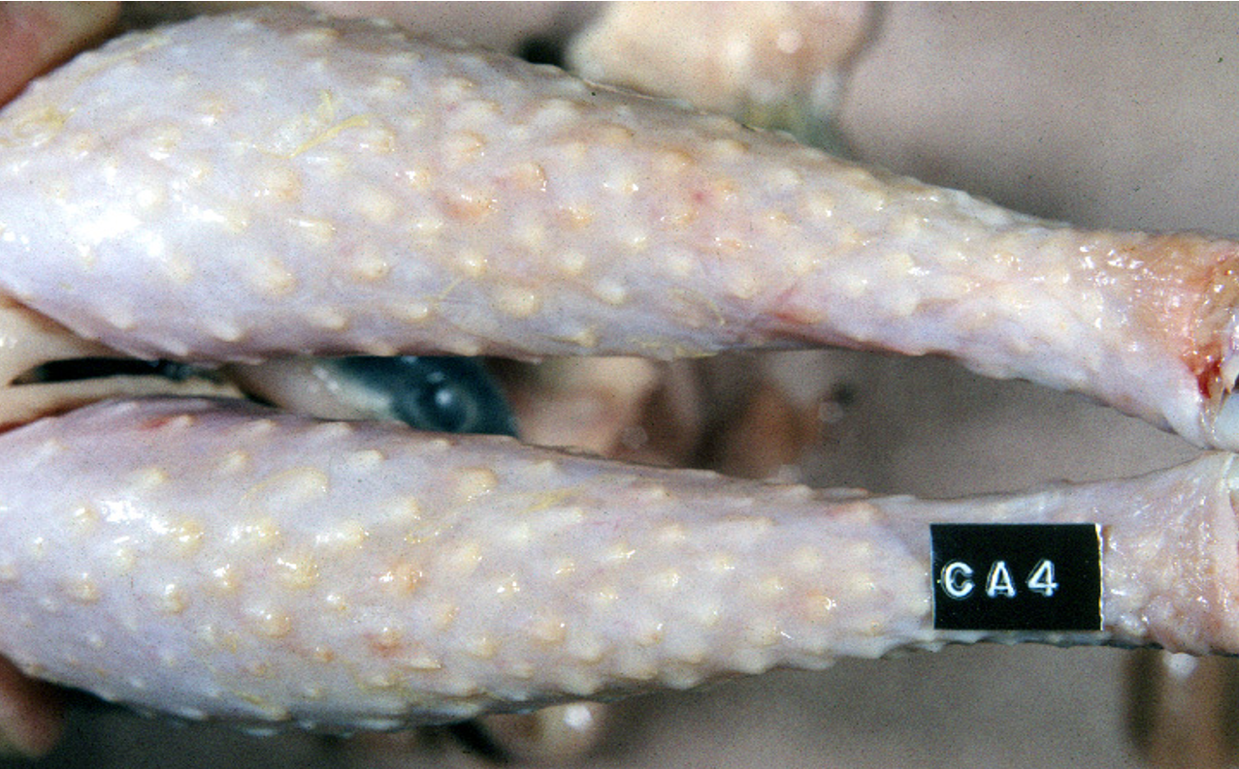

Slide 19
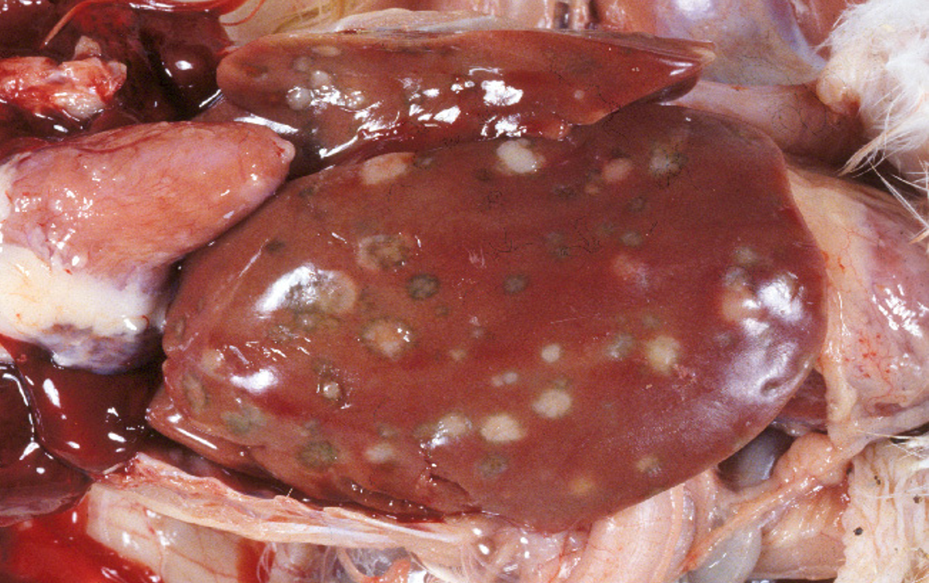
Liver Tumors

Slide 20
Avian Influenza (“AI” or “Bird Flu”)
Highly Pathogenic (HPAI) and Mildly or Low Pathogenic strains
Wild birds, most commonly waterfowl, can introduce virus to domesticated flocks through nasal secretions and manure of infected birds, as well as rodents and insects!
Can remain viable for long periods of time in moderate temperatures and can live indefinitely in frozen material.
When the highly pathogenic form is detected, national and international regulations require strict quarantine and rapid destruction of all infected flocks within a certain mile radius.
Characterized by:
Coughing
Sneezing
Swelling of the face and/or wattles
Bluish-purple discoloration of the face
Diarrhea
Red or white spots on the legs and comb

Slide 21
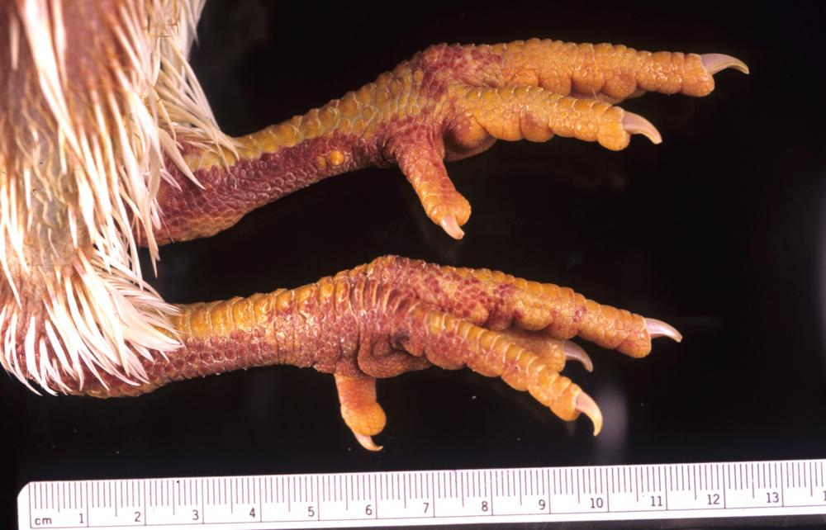

Slide 22
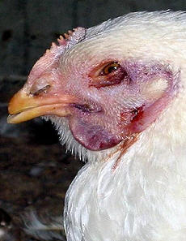

Slide 23
Fowl Pox (“Chicken Pox”)
No, this is not the same kind you may have had. ☺
Virus that can affect most types of poultry, as well as parrots and other pet birds.
Several species of mosquitoes can transmit Fowl Pox and play a significant role in spreading the virus from one frock to another
Can also be spread through direct bird-to-bird contact through their eyes, skin wounds, or when they breathe since Fowl Pox is airborne.
No effective treatment.
Characterized by:
Coughing
Sneezing
Gasping
Discharge from the eyes
Retarded growth
Warts or scabs

Slide 24
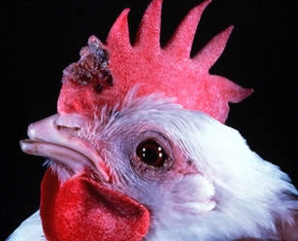
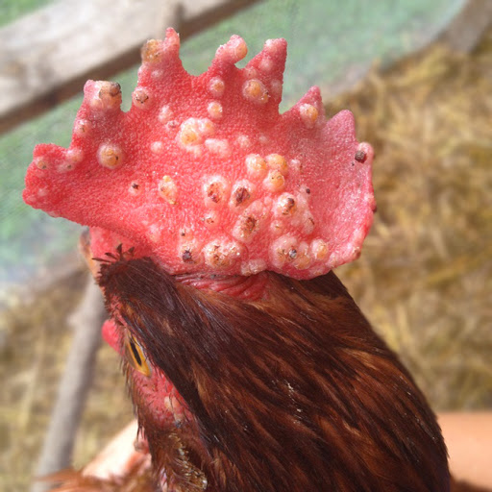

Slide 25
Infectious Bronchitis (“IB”)
Virus that affects chickens that is highly contagious and can spread quickly through a flock
Transmitted through the air and on feed bags, infected dead birds, and rodents as well as through the egg to developing embryos (although if affected they do not typically hatch)
No specific treatment besides administering antibiotics
Characterized by:
Gasping
Discharge from the eyes and/or nose
Reduced egg production
Production of thin-shelled eggs

Slide 26
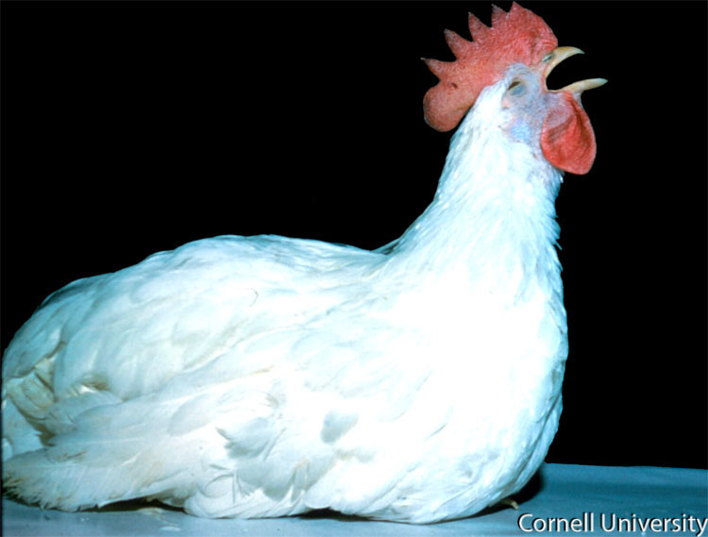
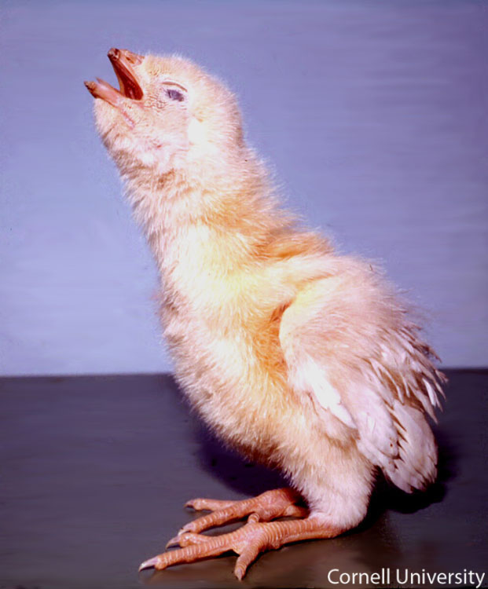

Slide 27
Laryngotracheitis (“LT” or “Laryngo”)
Chickens 14 weeks and older are more susceptible to this virus than young birds, with most outbreaks occurring in mature hens
Can spread from flock to flock by contaminated clothing, shoes, and tires or from bird-to-bird through the air on respiratory secretions
Characterized by:
Coughing
Sneezing
Shaking head
Gasping
Discharge from the eyes and/or nose
Swelling of the face and/or wattles
Retarded growth
Diarrhea
Conjunctivitis
Prostration

Slide 28
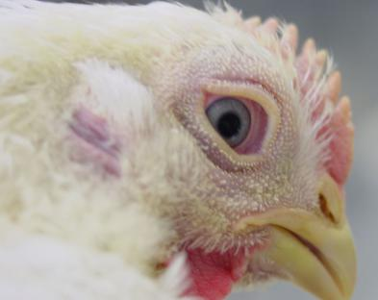
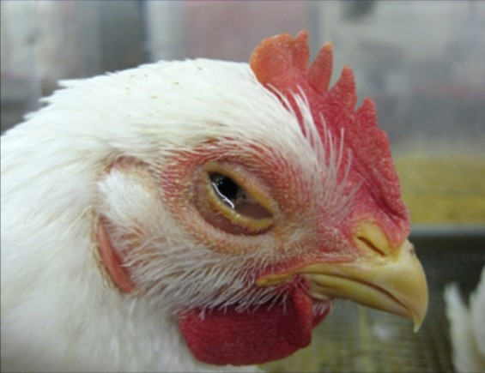

Slide 29
Newcastle Disease
This virus can be transmitted through the air within short distances.
Sick birds can transfer the virus directly to flock mates through body secretions and fecal matter, or through a person’s shoes, tires, dirty equipment, feed sacks, crates, etc.
Wild birds can also be infected, and transfer the virus through infected eggs (embryos typically die before hatching)
Mortality ranges from 10-80% depending on the strain
Characterized by:
Coughing
Sneezing
Shaking head
Gasping
Discharge from eyes and/or nose
Swelling of the face and/or wattles
Bluish-purple discoloration of the face
Retarded growth
Diarrhea (maybe green and watery)
Twisting of the head and neck

Slide 30
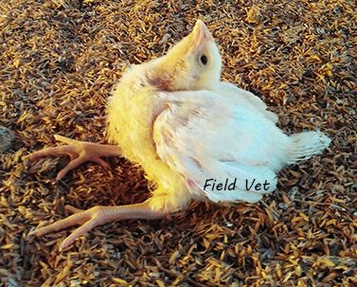
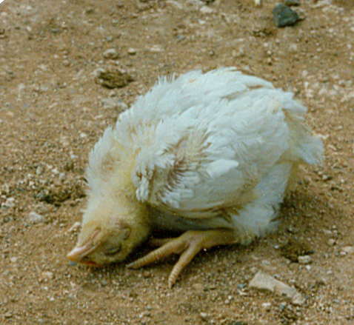

Slide 31
Poultry Science: Poultry Health
Unit 9: Segment 3
Vaccinations & Antibiotics

Slide 32
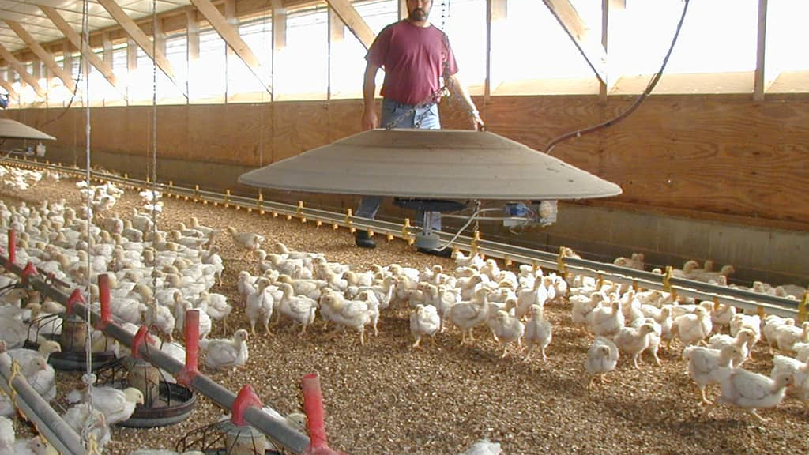
Vaccinations
Vaccination plays an important part in the health management of the poultry flock.
There are numerous diseases that are prevented by vaccinating the birds against them.
A vaccine helps to prevent a particular disease by triggering or boosting the bird’s immune system to produce antibodies that in turn fight the invading causal organisms.
There are 3 types:
Live
Attenuated
Killed

Slide 33
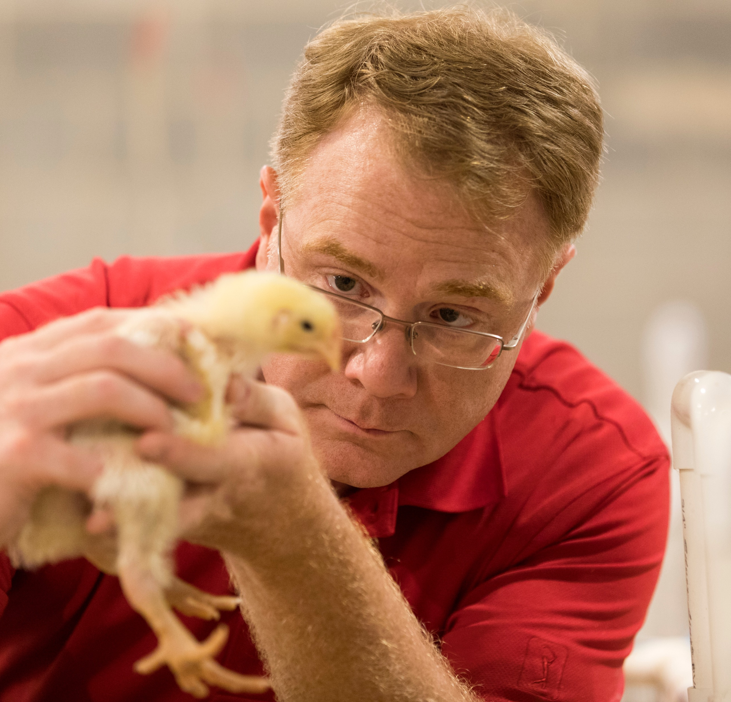
Live Vaccines
The active part of the vaccine is the live organism that causes the disease.
As such, it is capable of inducing the disease in birds that have not had previous contact that organism.
Vaccinated birds, in many cases, are able to infect non-vaccinated birds if housed together.

Slide 34
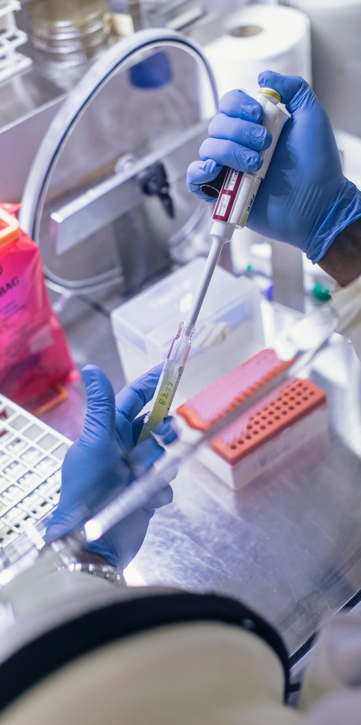
Attenuated Vaccines
With this type of vaccine the organism has been weakened by special procedures during manufacture so that it has lost its ability to cause the serious form of the disease.
At worst, the birds may contract a very mild form of the disease, however, the vaccine still has the ability to trigger the immune system to produce antibodies.

Slide 35
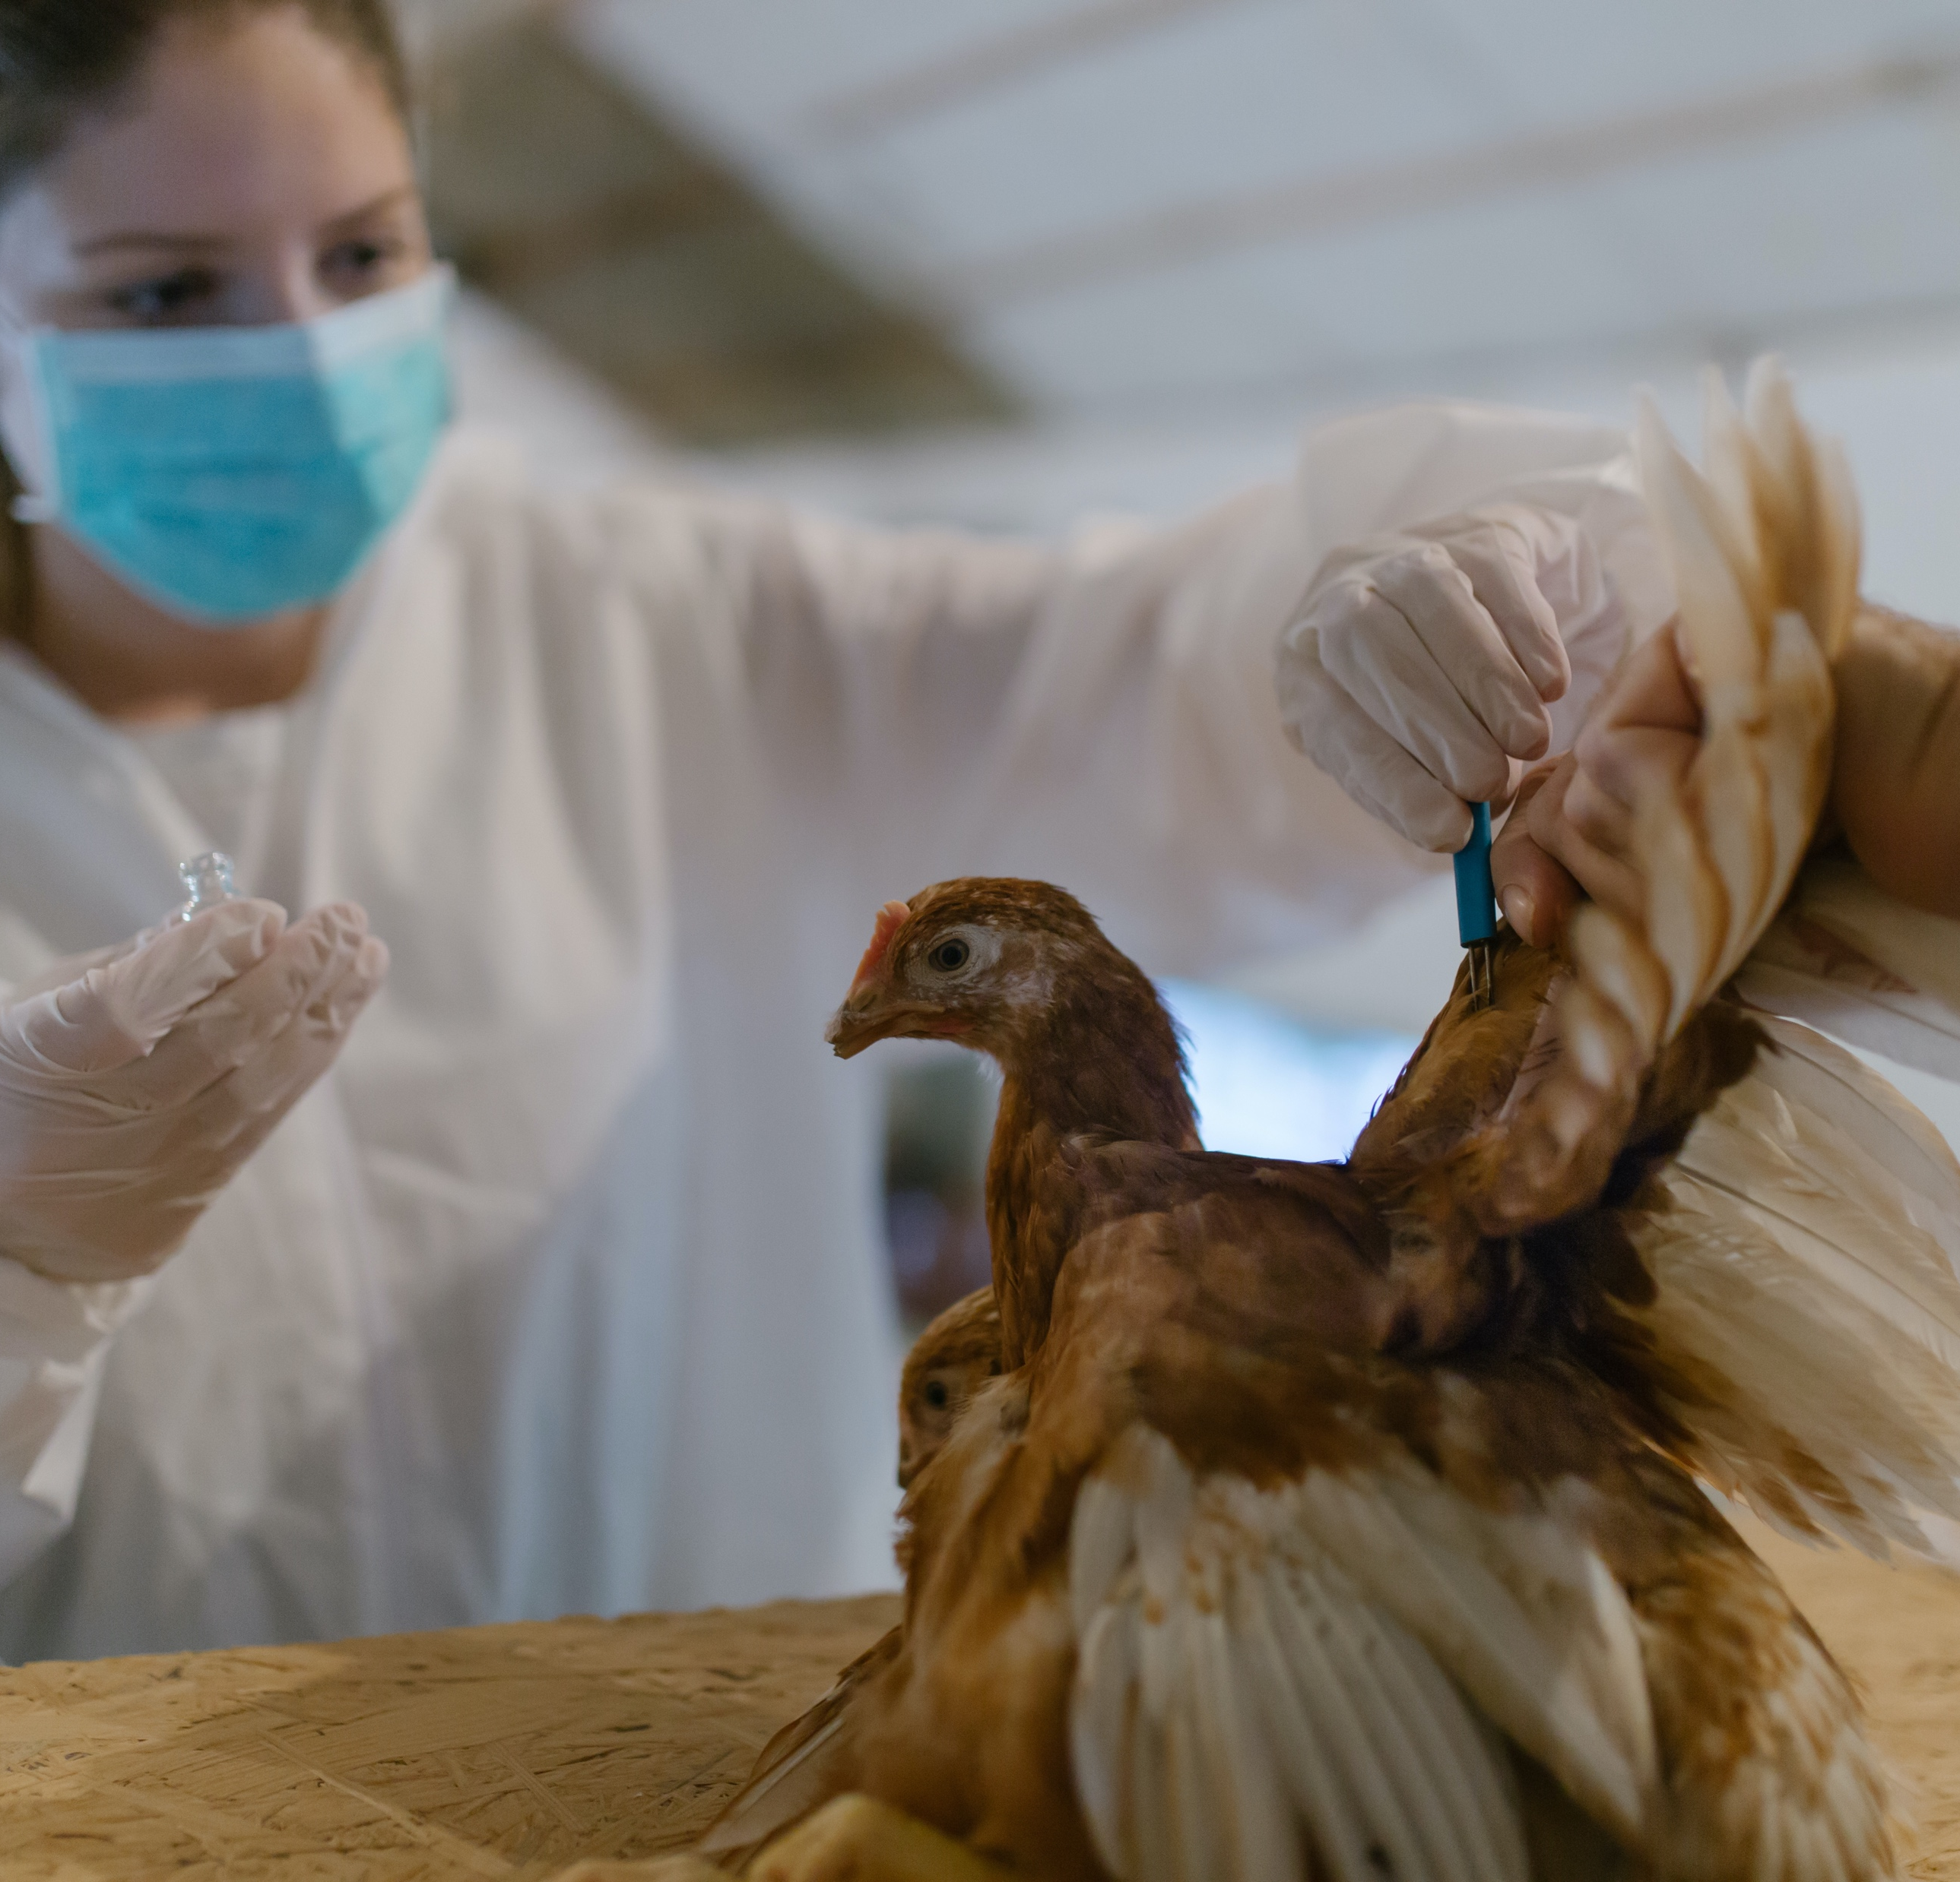
Killed Vaccines
With this type of vaccine the organism has been killed and is unable to cause the disease, although the ability to trigger the immune system remains.
In many cases, the level of immunity produced by this form of vaccine is weaker than that produced by live and attenuated vaccines.

Slide 37
Poultry Science: Poultry Health
Unit 9: Segment 4
Biosecurity in Commercial & Backyard Poultry Flocks

Slide 38
Biosecurity
Biosecurity - proven, cost effective techniques to control and prevent the spread of diseases in poultry operations
In an expanding global economy, it is of extreme importance to protect the health of poultry flocks in order to maintain and improve efficiencies and minimize economic losses due to disease outbreaks.

Slide 40
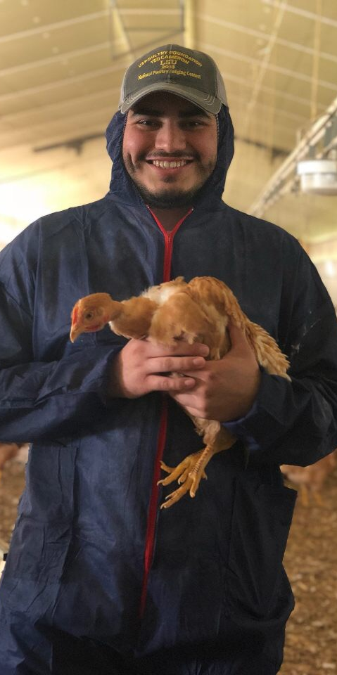
Standard Biosecurity
Restrict visitors
Do not visit other farms
People & equipment are the biggest problem
Dedicated poultry house clothing
Visitors log
Disposable boots, coveralls, etc.
Use locks on doors
Fences and gates surrounding farm
No other birds
No pets in chicken houses

Slide 41
Poultry Science Curriculum References
Jessica Fife, UGA Dept. of Poultry Science Outreach Coordinator, UGA Dept. of Agricultural Leadership, Education, & Communication MAEE Candidate
Barry Croom, UGA Dept. of Agricultural Leadership, Education, & Communication Professor
Ashley Yopp, UGA Dept. of Agricultural Leadership, Education, & Communication Assistant Professor
Georgia Agriculture Education
Andrew Benson, UGA Dept. of Poultry Science Assistant Professor
Brian Jordan, UGA Dept. of Poultry Science Assistant Professor, UGA College of Veterinary Medicine Assistant Professor
University of Arkansas Bumpers College of Poultry Science – Poultry Science Dual Curriculum Course
Julia Gaskin, UGA Dept. of Crop and Soil Sciences Sr. Public Service Associate
Glendon Harris, UGA Dept. of Crop and Soil Sciences Professor & Extension Agronomist
Brian Kiepper, UGA Dept. of Poultry Science Associate Professor
Claudia Dunkley, UGA Dept. of Poultry Science Public Service Associate
Casey Ritz, UGA Dept. of Poultry Science Professor
USPOULTRY & USPOULTRY Poultry Science Curriculum
Tom Tabler, Mississippi State University Department of Poultry Science Extension Professor
Jacquie Jacob, University of Kentucky
Jeanna Wilson, UGA Dept. of Poultry Science Professor
Kelly Sweeney, UGA Dept. of Poultry Science Ph.D Candidate
Merck Veterinary Manual
University of Maryland Extension
Poultry Hub
Brian Fairchild, University of Georgia Department of Poultry Science Professor
Centers for Disease Control
National FFA Organization

